Slide 1
55 New Features In JDK 9
Simon Ritter
Deputy CTO, Azul Systems

Slide 2

Major Features

Slide 3

Modularity/Jigsaw
Standard class libraries modularised (JEP 220)
rt.jar now 85 modules
Most internal APIs now encapsulated (JEP 260)
Some can be used with command line option
sun.misc.Unsafe
Modular source code (JEP 201)
JDK source code re-organised to support modules
Not the module system

Slide 4
jlink: The Java Linker (JEP 282)
Modular run-time
image
jlink
bin
conf
…
$ jlink --modulepath $JDKMODS \
--addmods java.base –output myimage
$ myimage/bin/java –listmods
java.base@9.0

Slide 5
jlink: The Java Linker (JEP 282)
$ jlink --modulepath $JDKMODS:$MYMODS \
--addmods com.azul.app –output myimage
$ myimage/bin/java –listmods
java.base@9.0
java.logging@9.0
java.sql@9.0
java.xml@9.0
com.azul.app@1.0
com.azul.zoop@1.0
com.azul.zeta@1.0
Version numbering for
information purposes only
“It is not a goal of the module system to solve the version-selection problem”

Slide 6
Factory Methods For Collections (JEP 269)
Static factory methods on List, Set and Map interfaces
Create compact, immutable instances
0 to 10 element overloaded versions
Set<String> set = new HashSet<>();
set.add("a");
set.add("b");
set.add("c");
set = Collections.unmodifiableSet(set);
Set<String> set = Set.of("a", "b", "c");

Slide 7

Stream Enhancements
dropWhile()/takeWhile()
Like skip/limit but uses Predicate rather than number
Improved iterate
Enables a stream to be more like a for loop
Parallel Files.lines()
Memory mapped, divided on line break boundary
Stream from Optional
Stream of zero or one elements

Slide 8

Multi-Release Jar Files (JEP 238)
Multiple Java release-specific class files in a single archive
Enhance jar tool to create multi-release files
Support multi-release jar files in the JRE
Classloaders
JarFile API
Enhance other tools
javac, javap, jdeps, etc.
Also, modular jar files

Slide 9
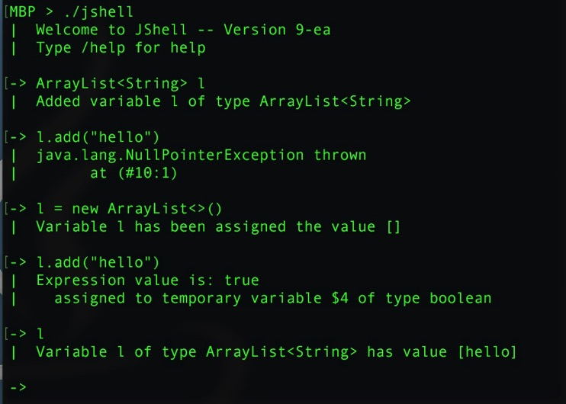
REPL: jshell (JEP 222)
Read-Eval-Print Loop
Simple prototyping

Slide 10

Concurrency Updates (JEP 266)
Reactive streams publish-subscribe framework
Asynchronous, non-blocking
Flow
Publisher, Subscriber, Processor, Subscription
SubmissionPublisher utility class
Asynchronously issues items to current subscribers
Implements Flow.Processor

Slide 11

Concurrency Updates (JEP 266)
CompletableFuture additions
Delays and timeouts
Better support for sub-classing
New utility methods
minimalCompletionStage
failedStage
newIncompleteFuture
failedFuture

Slide 12

Enhanced Deprecation (JEP 277)
We have @deprecated and @Deprecated
Used to cover too many situations
New methods in Deprecated annotation
boolean forRemoval()
Will this ever be removed?
String since()
JDK Version when this was deprecated
Several @Deprecated tags added
java.awt.Component.{show(),hide()} removed
Notes:
forRemoval - Interesting. Tri-state (i.e. it may not be present on the annotation).

Slide 13

Milling Project Coin (JEP 213)
Underscore no longer valid as identifier
Ready for use in Lambdas
Private methods in interfaces
Multiple inheritance of behaviour makes this logical
Effectively final variables in try-with-resources
Variables from outside try block
Allow @SafeVarargs on private instance methods
In addition to constructors, final and static methods
Diamond operator with anonymous classes
Extending type inference further

Slide 14

Standards

Slide 15


Updating To Relevant Standards
Unicode 7.0/8.0 (JEP 227/267)
7.0: 2,834 new characters
8.0: 7,716 new characters
PKCS12 key stores by default (JEP 229)
Move from JKS to PKCS12
HTML5 javadocs (JEP 224)
Flashier documentation
SHA 3 hash algorithms (JEP 287)
Keeping ahead of the hackers
}
seriously!
Notes:
Unicode 7: Lots of emojis, the Ruble symbol and Manat from Azerbaijan
Unicode 8: Cherokee (lower case) some African languages and more emojis

Slide 16
Smaller Features
UTF-8 property files (JEP 226)
ResourceBundle API updated to load these files
DRBG-Based SecureRandom implementations (JEP 273)
Deterministic Random Bit Generator
XML Catalog API (JEP 268)
Supports OASIS XML catalog API v1.1
For use with JAXP
Notes:
XML catalog is a document describing a mapping between extenal entity references and locallly cached equivalents. (Useful for things like DTDs)

Slide 17

Inside The JVM

Slide 18

Default Collector: G1 (JEP 248)
G1 now mature in development
Designed as low-pause collector
Concurrent class unloading (JEP 156) JDK8u40
Useful enhancement to improve G1
Still falls back to full compacting collection
Pause times proportional to heap size
Use Zing from Azul for truly pauseless
Notes:
Concurrent class unloading means not having to do a full GC to unload classes
Making G1 default may affect thruput
Higher resource requirements
Reasons to

Slide 19

Better String Performance
Compact strings (JEP 254)
Improve the space efficiency of the String class
Not using alternative encodings
Store interned strings in CDS archive (JEP 250)
Share String and char[] objects between JVMs
Indify String concatenation (JEP 280)
Change from static String-concatenation bytecode sequence to invokedynamic
Allow future performance improvements
Notes:
CDS = Class Data Sharing

Slide 20
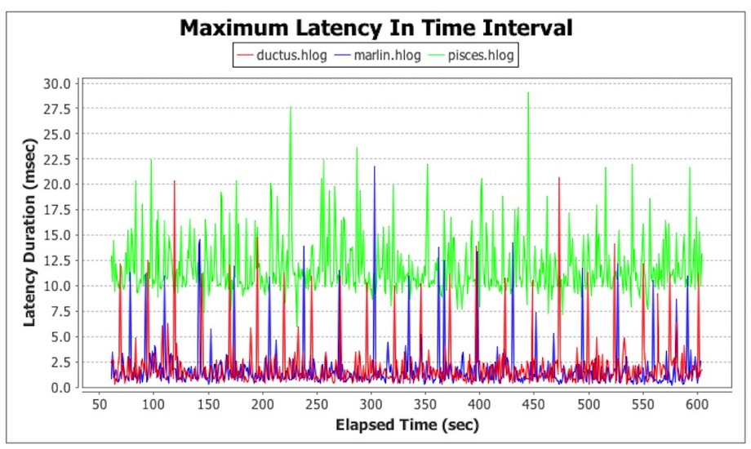
Marlin Graphics Renderer (JEP 265)
Replaces Pisces open-source renderer
Comparable performance to closed-source Ductus

Slide 21
Smaller Features
Improve contended locking (JEP 143)
Field reordering/cache line alignment
Leverage CPU instructions for GHASH and RSA (JEP 246)
34-150x better performance (for certain tests)
Update JavaFX to newer version of GStreamer (JEP 257)
Media class
Better security, stability and performance

Slide 22

Smaller Features
Segmented Code Cache (JEP 197)
Separate non-method, profiled and non-profiled code
Unified JVM logging (JEP 158)
Common logging system for all components of JVM
Unified GC logging (JEP 271)
Re-implement GC logging using unified JVM logging
Notes:
Segmented code cache to improve performance and allow future developments (Sumatra and the use of GPUs)

Slide 23

Specialised

Slide 24


Spin-Wait Hints (JEP 285)
Proposed by Azul
We rock!
A new method for Thread class
onSpinWait()
Enables the x86 PAUSE instruction to be used from Java code
If available
Ignored otherwise
Improved performance for things like Disruptor

Slide 25

Variable Handles (JEP 193)
Replacement for parts of sun.misc.Unsafe
Fence operations
Fine grained memory control
Atomic operations on object fields and array elements
VarHandle
compareAndExchange(), compareAndSet()
getAndAdd(), getAndSet()
acquireFence(), releaseFence()

Slide 26
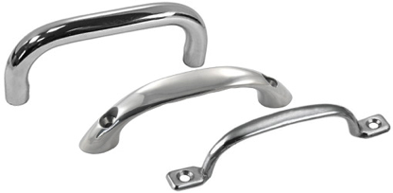
Enhanced Method Handles (JEP 274)
Support for
loops
try/finally blocks
Better argument handling
Spreading
Collection
Folding
More lookup functions
Non-abstract methods in interfaces, classes
Notes:
MethodHandles utility class
loop, countedLoop, whileLoop, tryFinally static methods
spreading - arg array to individual args
Collection - args to arg array
Folding - Pre-prasing of arguments

Slide 27

Smaller Features
Compiler control (JEP 165)
Control of C1/C2 JIT, not javac
Directive file
Runtime changes via jcmd
Process API updates (JEP 102)
Native process (Process/ProcessHandle)
More information: pid, arguments, start time, CPU usage, name
Control subject to security manager permissions

Slide 28

Housekeeping

Slide 29

New Version String Format (JEP 223)
Old
Limited update release/Critical patch update (CPU)
JDK 8u121 or jdk1.8.0_u121
Which has more patches, JDK 7u55 or JDK 7u60?
New
JDK $MAJOR.$MINOR.$SECURITY.$PATCH
Easy to understand by humans and apps
Semantic versioning

Slide 30
JDK/JRE File Structure (JEP 220)
Pre-JDK 9
JDK 9
bin
jre
lib
bin
conf
lib
tools.jar
jre directory
tools.jar
rt.jar
bin
lib
rt.jar

Slide 31

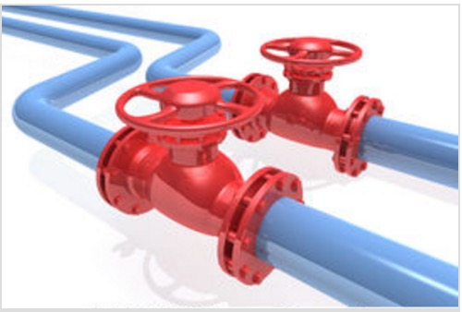

Smaller Features
Searchable API documentation (JEP 225)
Finally! Java API docs enter the 21st century
Annotations pipeline 2.0 (JEP 217)
Repeating, type and Lambda annotations in JDK 8
Redesign of javac annotation pipeline
Parser API for Nashorn (JEP 236)
API for Nashorn abstract tree syntax

Slide 32

General Clean Up
Disable SHA-1 certificates (JEP 288)
Mostly
In some situations SHA-1 certs. will still be accepted
Deprecate the Applet API (JEP 289)
Not many people still use this

Slide 33
Removed From JDK 9
Six deprecated APIs (JEP 162)
ActionListeners in Pack200 and LogManager
JRE version selection command line option (JEP 231)
-version: no longer accepted
Demos and samples (JEP 298)
Out-of-date, unmaintained

Slide 34
Removed From JDK 9
JVM TI hprof agent (JEP 240)
Only ever intended as a demo of JVM TI
Useful features now in other tools (like jmap)
Remove the jhat tool (JEP 241)
Experimental tool added in JDK 6
Unsupported
Better heap visualisation tools available

Slide 35
Removed GC Options (JEP 214)
Deprecated in JDK 8 (JEP 173)
DefNew + CMS : -XX:-UseParNewGC -XX:+UseConcMarkSweepGC
ParNew + SerialOld : -XX:+UseParNewGC
ParNew + iCMS : -Xincgc
ParNew + iCMS : -XX:+CMSIncrementalMode -XX:+UseConcMarkSweepGC
DefNew + iCMS : -XX:+CMSIncrementalMode -XX:+UseConcMarkSweepGC
-XX:-UseParNewGC
CMS foreground : -XX:+UseCMSCompactAtFullCollection
CMS foreground : -XX:+CMSFullGCsBeforeCompaction
CMS foreground : -XX:+UseCMSCollectionPassing

Slide 36
Incubator Modules (JEP 11)
Develop APIs without making them part of the standard
At least not straight away
Allow developers to “kick the tyres”
Not always possible to get a new API right first time
Move from incubator to full module
Becomes part of the standard
JDK 9 only has one incubator: HTTP/2 (JEP 110)
Some concerns about fragmentation
--do-not-resolve-by-default

Slide 37

Summary

Slide 38
JDK 9
Big new feature is modularity
Covers numerous different areas
Modules, jink, jmods, etc.
Smaller developer features
New APIs for streams
Reactive API
REPL/jshell
Many smaller performance/standards features
Time to start testing, if you’re not already

Slide 39
Zulu Java
Azul’s binary distribution of OpenJDK
Passes all TCK tests
Multi-platform (Windows, Linux, Mac)
FREE!
Happy to sell you support, including older versions
JDK 6, 7, 8 and 9 (Early Access)
www.zulu.org/download

Slide 40
Questions
Simon Ritter
Deputy CTO, Azul Systems

